Slide 1
Trees, Forests and Islands
A Machine learning approach to Nuclear Physics https://arxiv.org/pdf/1907.09764.pdf
Nishchal Dwivedi dwivedi.nishchal@gmail.com
Indian Institute of Technology, Bombay

Slide 2
How did I arrive to Machine learning
Exact Semiclassical description of nuclear level densities (JPHYSG, (2015), 42, 115103 and IJMPE, (2019) 28.8, 1950061)
Our description gives exact description for spherical nuclear systems with no adjustable parameters
We get stuck when we have to incorporate deformation
How to model these “complex quantum systems”?
Machine Learning?
ML has been helpful in other fields and has provided us insights in physics in the terms of Astrophysics (classification of stars), Solid State Physics (paramagnetic and ferromagnetic classification and finding critical exponents), Quantum Physics (entanglement), etc

Slide 3
Methods – Random Forests
Collection of decision trees with randomly selected features (Bagging)
Many trees are used for prediction, hence Forest
Mainly two parameters, number of trees and no. of features to be selected at each node
The average value is taken as the predicted value
More features, more suitable for Random Forests
Reduces overfitting
Works well with Big data, hence scalable.

Slide 4
Methods – Gradient Boosted Trees
Residual = (actual value – predicted value)
Mean of the observed values is considered as the first predicted value and the difference between the mean and each value is taken as the first residual.
These residuals are made into a decision tree with features as the nodes.
A new model is thus generated on bases of the residuals and new residuals are calculated.
This is iterated and tweaked till the residuals are minimized.
Prone to overfitting, needs tweaking of number of iteration, depth of trees and learning rate

Slide 5
Samples with different features
Data
…
Average model
Random Forest
Evaluating Residuals
Data
Improved model
Gradient Boosted trees

Slide 6
Methods – Feature Generation
The next question is, how to decide on features
A ML feature should be informative, discriminating, and independent
Factors which are crucial in terms of physics of the nuclei
Number of neutrons and protons
Energy terms of the liquid drop model (volume, surface, Coulomb interaction, mass asymmetry and pairing energies)

Slide 7
Calculations
For Level Density Parameter, we took the data for spherical nuclei from semiclassical trace formula for various temperatures and trained the model.
We then tried to predict the level density parameter for super heavy elements.
We trained the ML model on data obtained by fitting the Fermi gas model with the neutron resonances (GC)
We did the same prediction with this model
Training to Testing -> 60-40 %
The standard deviation (σ), to quantify predictions, is the root mean square of difference between predicted values by the model and actual values given by the test data. Further, standard error is defined as the standard deviation divided by the square root of size of the sample.

Slide 8
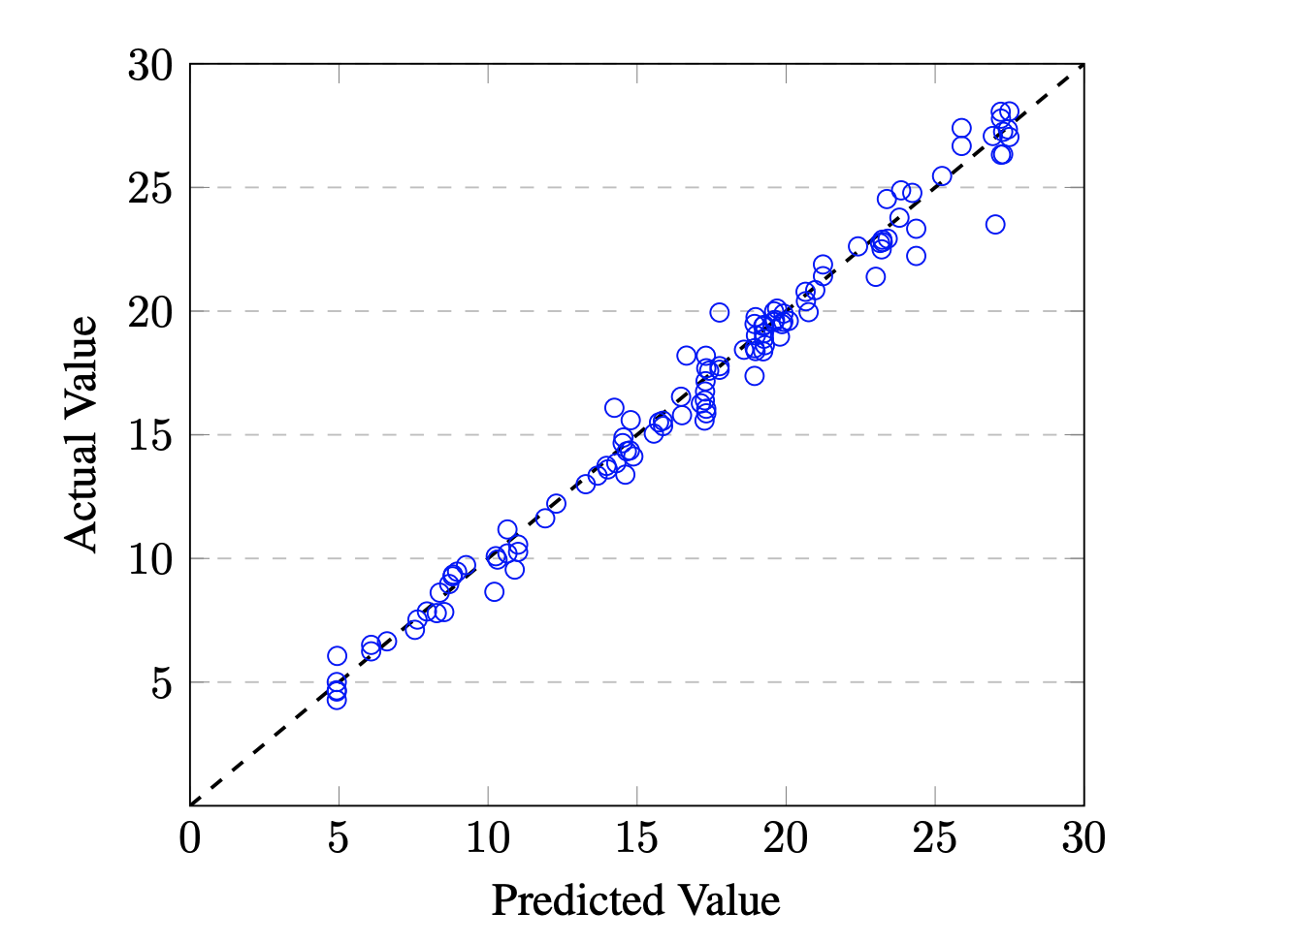
By training and testing Level Density Parameter by the GC model for 289 nuclei. Standard deviation of 0.73 and standard error of 0.042

Slide 9
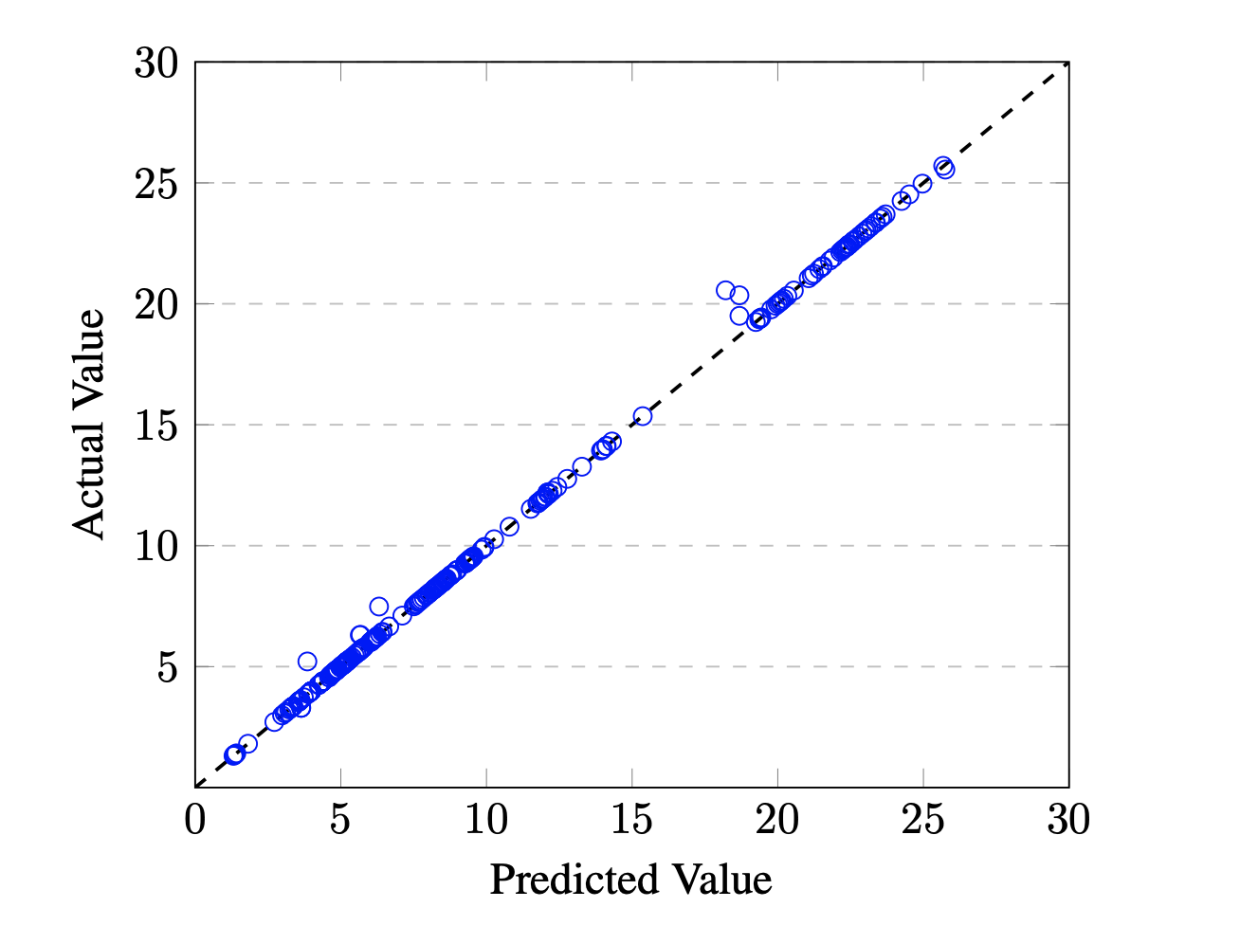
Training and testing on the temperature dependent Level Density Parameter by Semiclassical trace formula for 32 nuclei at various temperatures (3000 data points) Standard deviation of 0.3 and standard error of 0.005.

Slide 10
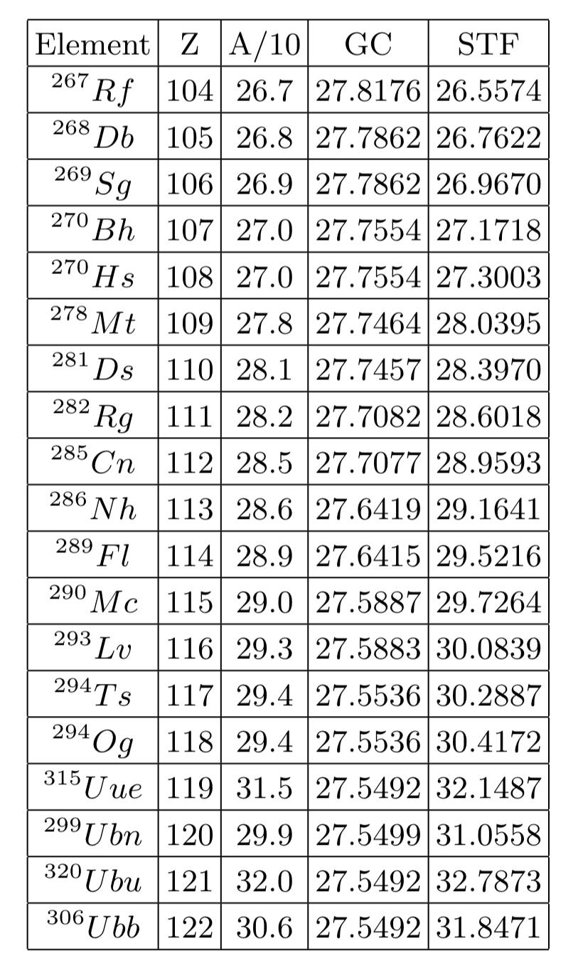
Results Random Forest Level Density Parameter

Slide 11
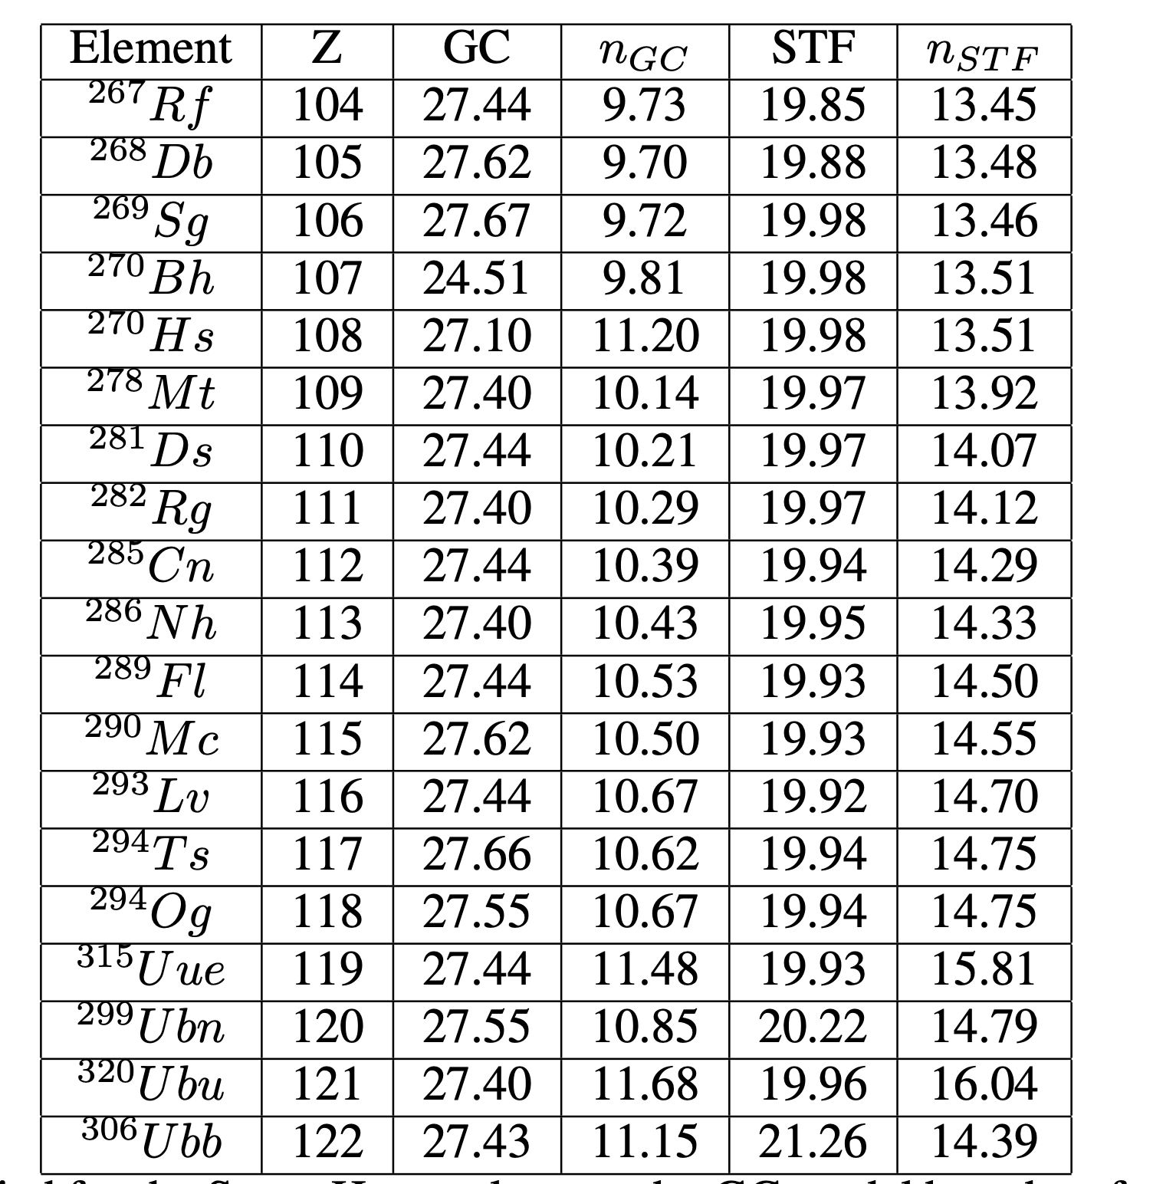
Results GBT- Level density parameter

Slide 12
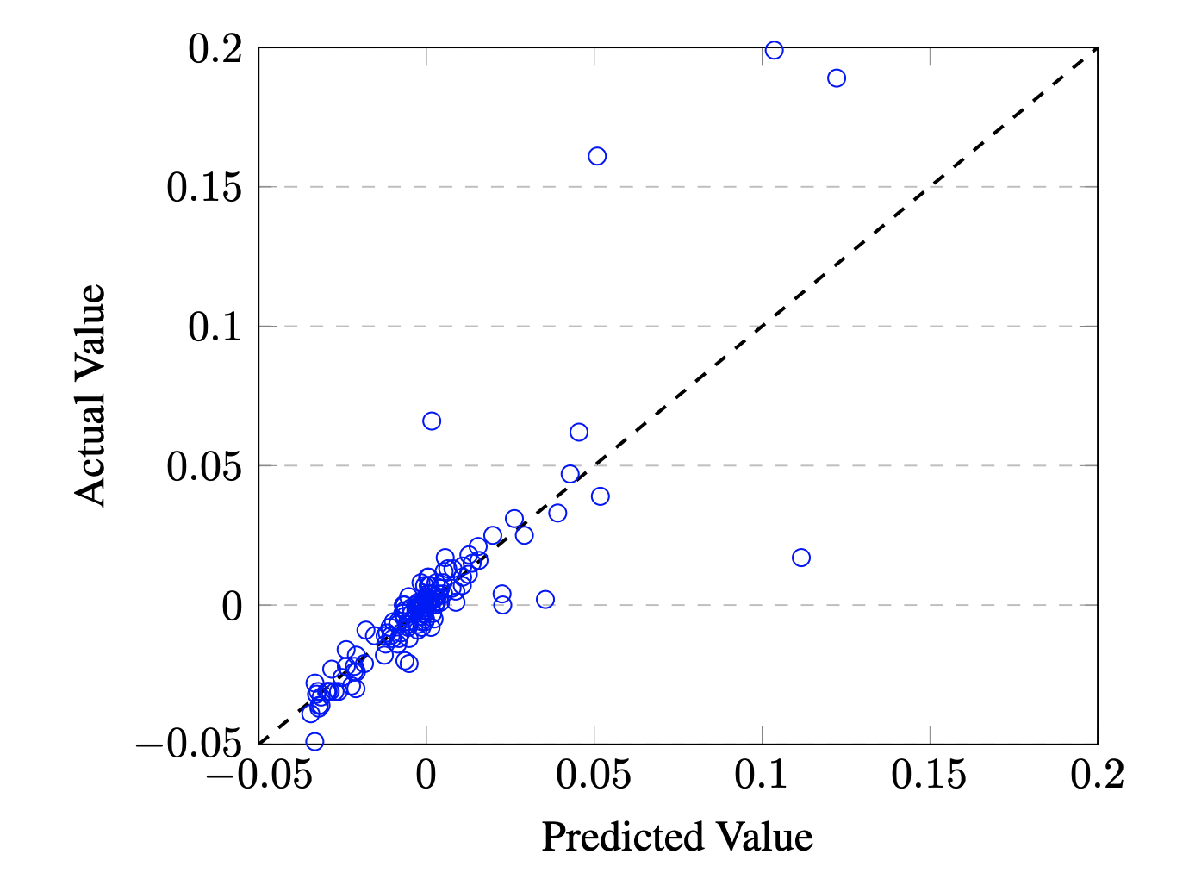
Prediction on 8983 values of calculated Quadrupole deformations, β2 Standard deviation of 0.3 and standard error of 0.005

Slide 13
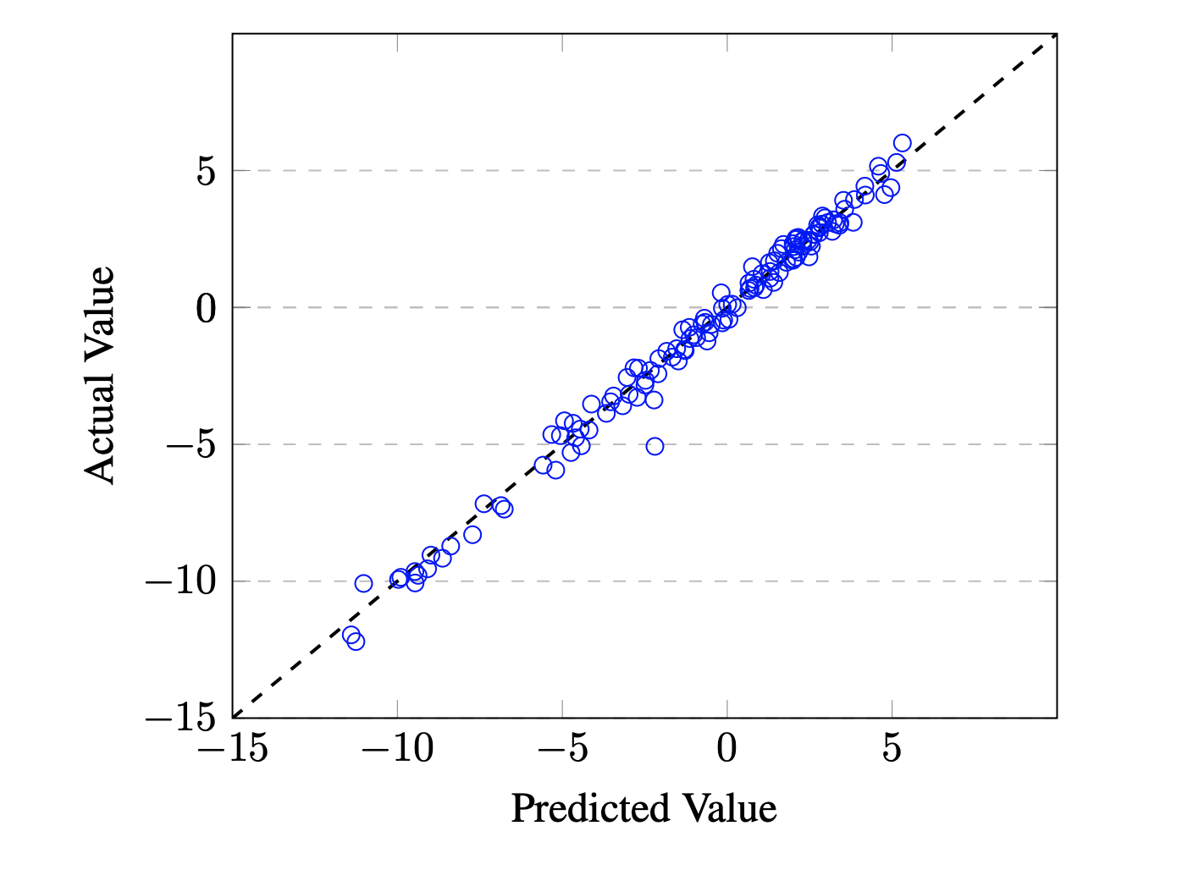
The predictions of Shell correction energy. 6735 Nuclei. Standard deviation of 0.553 and standard error of 0.0067

Slide 14
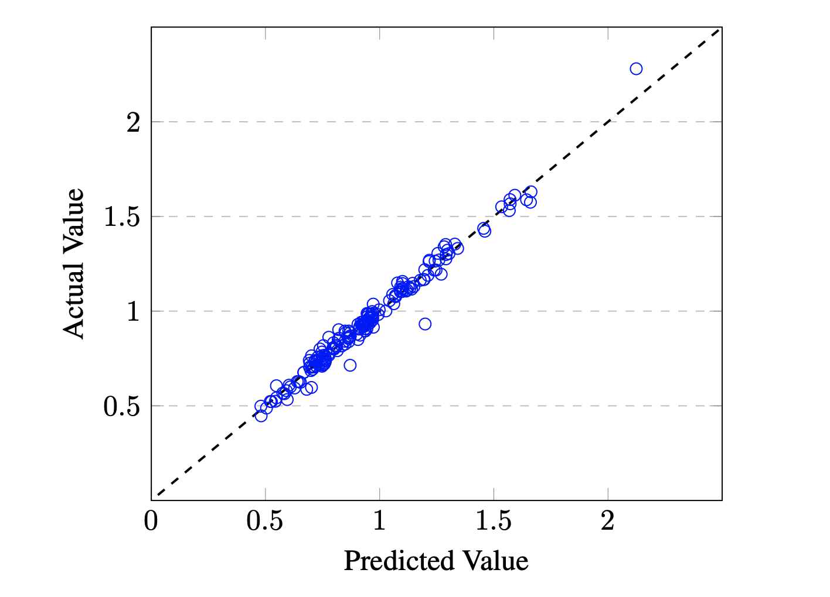
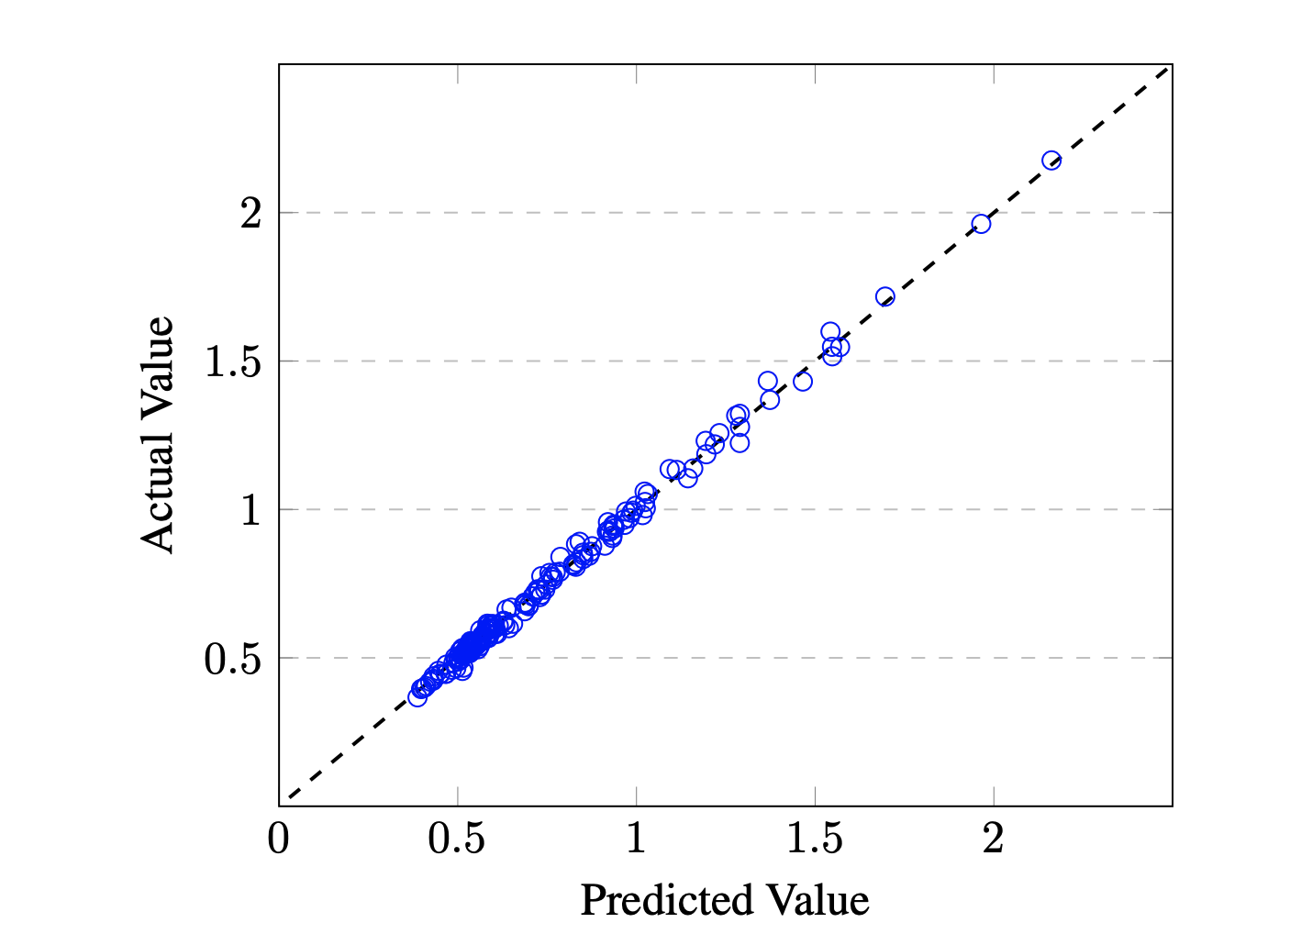
Proton and Neutron pairing gaps of 8969 nuclei Proton standard deviation of 0.037 and standard error of the order 10−4 . Neutron standard deviation of 0.037 and standard error of the order 10−4

Slide 15
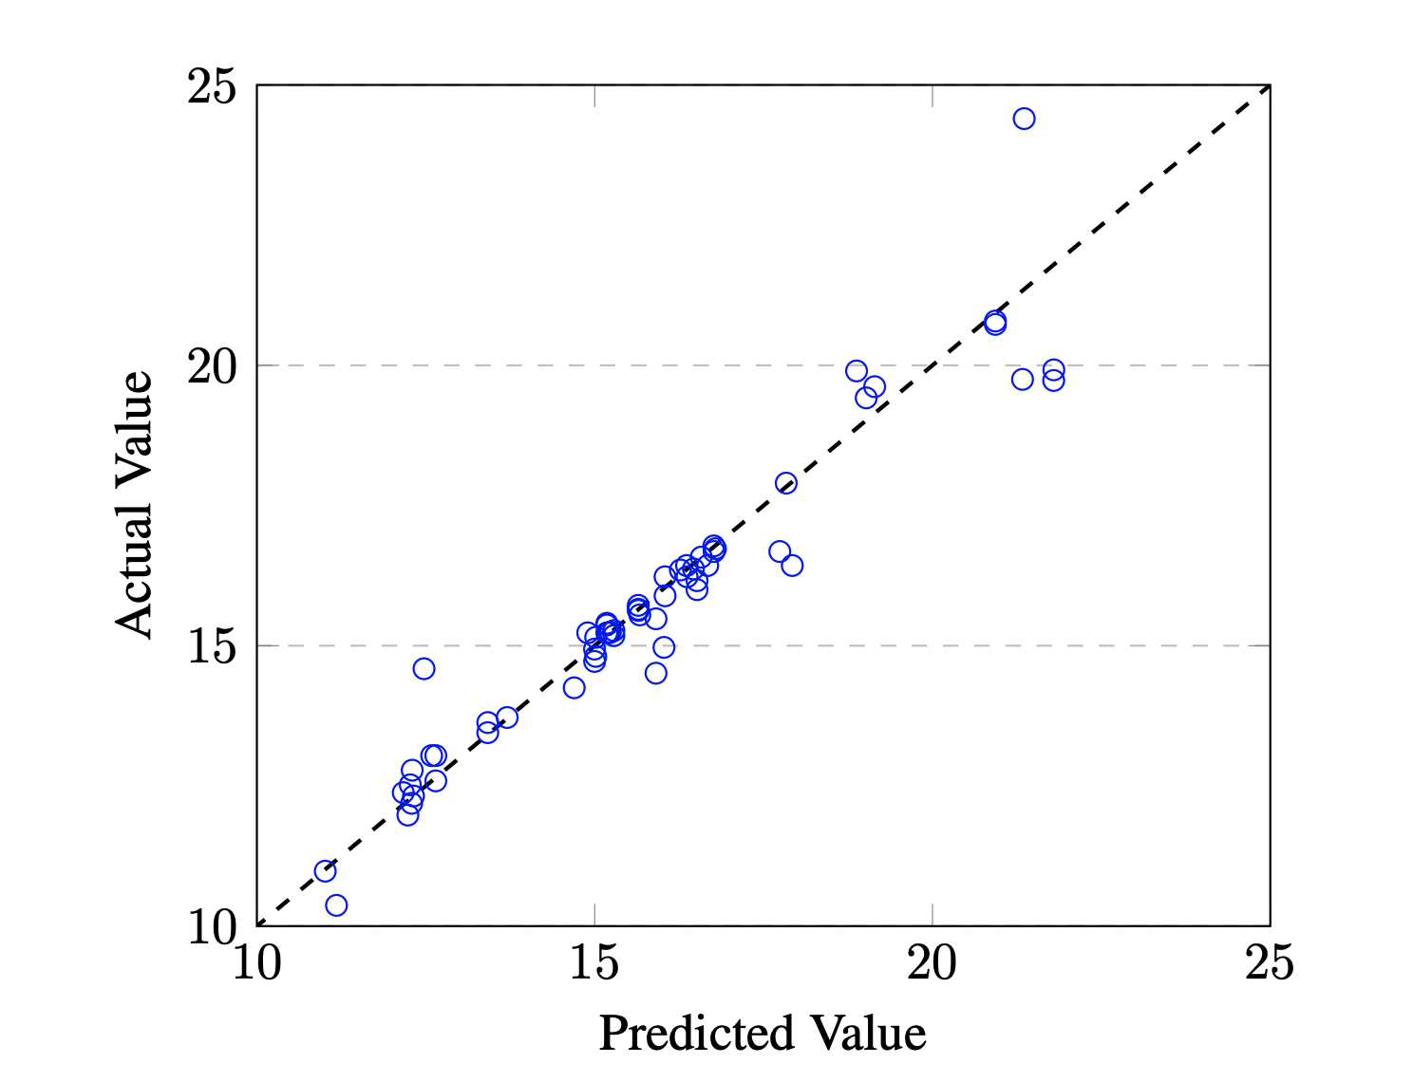
Training and testing the experimental first peak energy values for GDR for 180 nuclei Standard deviation of 0.73 and standard error of 0.042

Slide 16
Conclusion
Nuclear observables from models and experiments were both predicted using GBT.
The predictions from these models show a very good agreement with the actual values with standard deviations ranging from 0.00035 to 0.73. To compare with contemporary literature, similar investigations on time series analysis, molecular physics, astrophysics, economics and climate studies report standard deviations ranging between 0.02 to 75.0.
Questions of validity, are the data points enough, better features or better models, remain open to be explored.
Major challenges during feature engineering were overfitting and selecting the right features.

Slide 17
An Advertisement
Looking for Collaborations/Postdoc positions/Jobs Skills: Machine Learning, Semiclassical Physics PhD (Thesis Submitted) TEDx Speaker Lindau Nobel Laureate Meet
dwivedi.nishchal@gmail.com
Semiclassical triton, Nishchal R. Dwivedi, Harjeet Kaur and Sudhir R. Jain The European Physical Journal A, (2018) 54:9
Ignatyuk damping factor: A semiclassical formula, Nishchal R. Dwivedi, Saniya Monga, Harjeet Kaur and Sudhir R. Jain International Journal of Modern Physics E, (2019) 28.8, 1950061
Non-adiabatic transitions and non-equilibrium statistics of deforming nuclei, Nishchal R. Dwivedi and Sudhir R. Jain(2019) arXiv:1907.09763
Trees and Islands - Machine learning approach to nuclear physics, Nishchal R. Dwivedi (2019) arXiv:1907.097645.
Semiclassical description of α- radioactivity in even-even nuclei, Saniya Monga, Nishchal R. Dwivedi, Deepika Pathak Harjeet Kaur and Sudhir R. Jain Journal of Physics G (2019) 46(11), 115110
Spectral statistics of energy levels of152Dy, Nishchal R. Dwivedi, Bijay Agarwal and Sudhir R. Jain The European Physical Journal Special Topics (2020) 229.14, 2619:2628
Major Publications
11 Conference Proceedings 3 International Conferences organized University Gold medal

